Slide 1

Baskets and Ballers
Using Machine Learning to Profile Pro Players

Slide 2


The Team
Sneha
Shikha
Aaron
Ryan
2023
Yun
Using Machine Learning to Profile Pro Players
API - Pandas - Machine learning - Javascript - Flask API - Web App

Slide 3
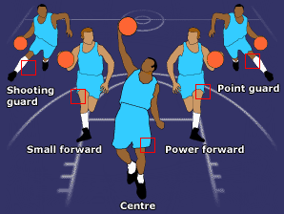
Purpose
Traditional groups for NBA players are based on their position in a game and the skills that position requires :
Point guard - Assists, Steals, Three Point Shots
Shooting guard - Points, Three Point Shots, Free Throw%
Small forward - Points, Defense Rebound, Field Goal %
Power forward - Total Rebound, Field Goal %, Blocks
Center - Total Rebounds, Blocks, Field Goal %
In reality, no player has the perfect combination of skills for a specific position. So the game play is governed by how well the skills of each player compliments the others’ on the team.
Clustering allows us to group players based on observed unique set of skills represented through their performance statistics. These groups provide insights for talent evaluation, team composition, and strategic decision-making in the context of basketball management and coaching.

Slide 4
Player Stats
19 metrics from season 2021, were used for each player who had at least 500 minutes of playtime:
Minutes: Total #minutes spent on court
PTS: Total points scored through the season
FGM, FGA, FG%: field goals made, attempted & %. All points made outside of free throws.
FTM, FTA, FTP%: free throws made, attempted & %. Awarded after fouls on the player from the opposing team.
TPM, TPA, TPM%: three-point field goals made, attempted & %.
totReb, offReb, defReb: Possession after a missed shot by either offensive or defensive
Assists: passes the ball to a teammate or defensive goaltending, that leads directly to a score
Steals: Positive aggression that leads to turnover
Blocks: legally deflects a field goal attempt from an offensive player to prevent a score
Turnovers: ball stolen, out of bounds, pass intercepted, committing a violation/foul that leads to loss of team possession
pFouls: rule breach that concerns illegal personal contact with an opponent
Offensive Players
Offensive Rebounds
Assists
Turnovers
Field Goals
Free Throws
Defensive Players
Defensive Rebounds
Blocks
Steals
pFouls

Slide 5
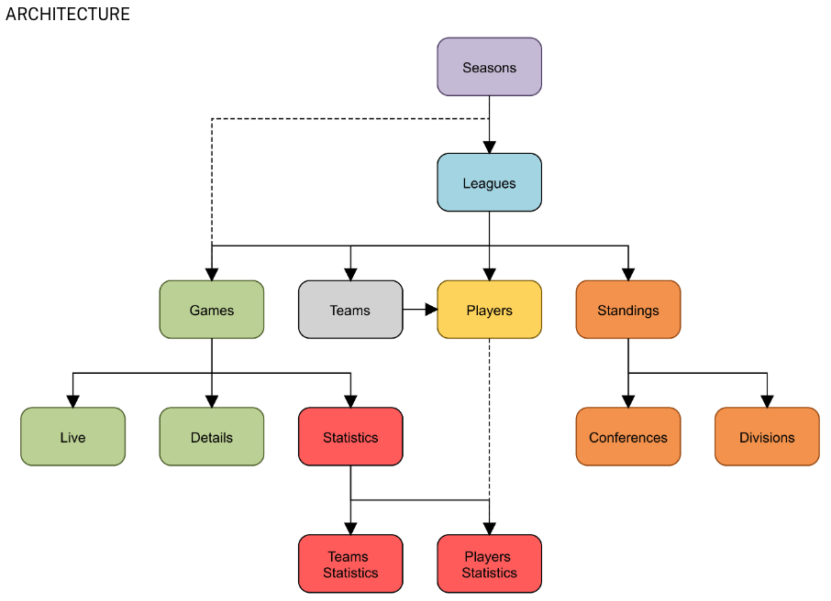
Data Sources and Cleaning
Source - https://rapidapi.com/api-sports/api/api-nba
Endpoints:
Players for demographic data
Player Statistics for game metrics
Steps:
Player demographics from Players Endpoint
Player stats for above Player IDs
Missing value treatment and format changes
Aggregation at player level and recalculation of derived metrics
Filter players with at least 500 minutes of playtime

Slide 6
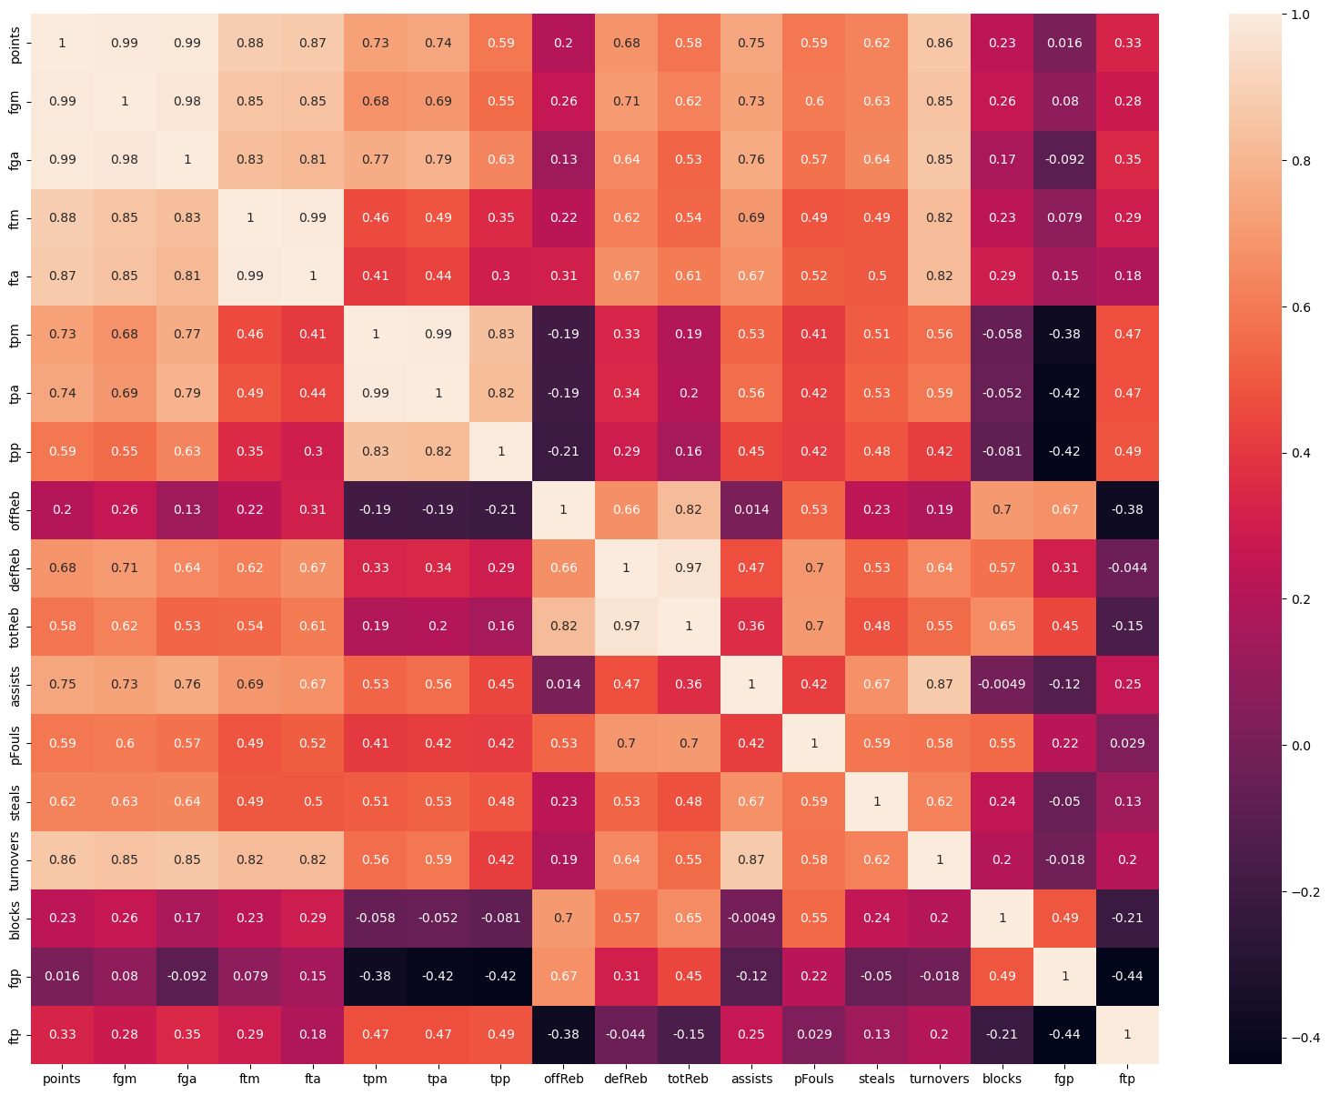
Machine Learning
Correlation Matrix
Field Goals , 3-Point goals , Free Throws were highly correlated - we hence retained only the derived % metrics FGP, FTP, TPP & points
Offensive and Defensive Rebounds replaced the sum ie. Total Rebounds
Data Normalization
Features were measured in different units.
Used ‘StandardScaler’ to prevent any single feature from dominating the clustering process.
REMOVED

Slide 7
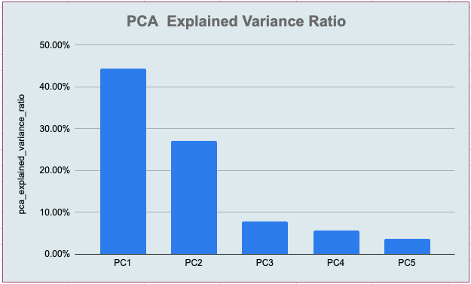
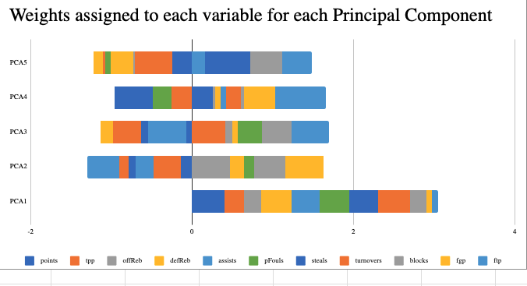
Machine Learning
Principal Component Analysis
11 metrics was the ‘curse of dimensionality’ in this dataset
PCA was performed to reduce the dimensionality to 5 features hence improve the model speed and efficiency
Principal Components Results
5 principal components explained 88.6% of the variance
PC1 and PC2 contributed to 71% of this variance
PC1 and PC2 have very different distribution of weights across the 11 features as shown here

Slide 8
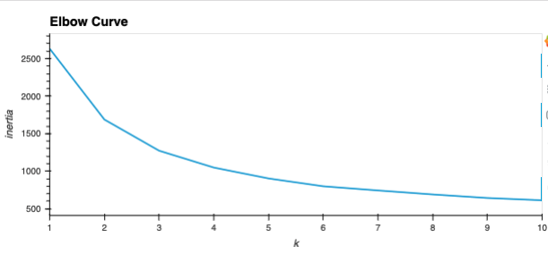
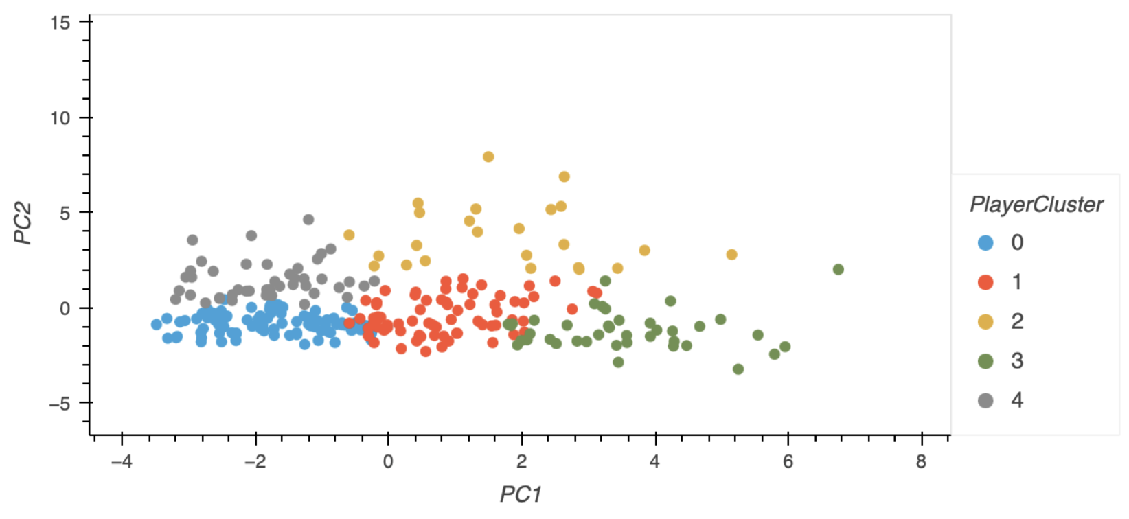
Machine Learning
K-Means Elbow Curve
Using 5 PC features - the k means elbow curve determined 5 optimal clusters before drop in inertia was negligible
K Means Clustering
Using PC1 and PC2 that explained 71% of the variance - the distinction in clusters was clear from the scatter plot
Data for App Visualizations:
Data was aggregated at the Cluster, Position and Player level
MinMaxScaler was used to ensure they could be rendered on a radar chart that requires only positive normalized values

Slide 9
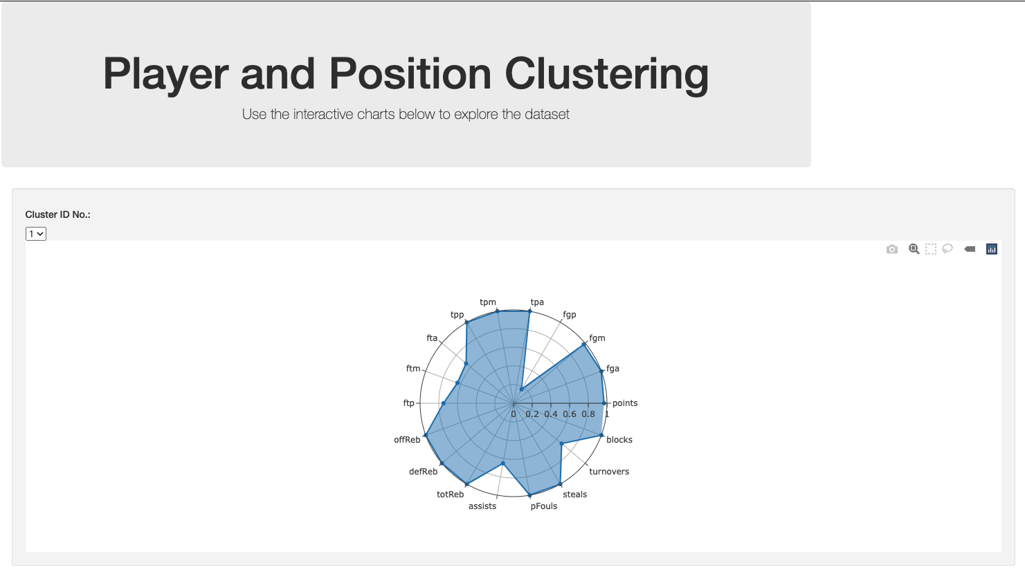
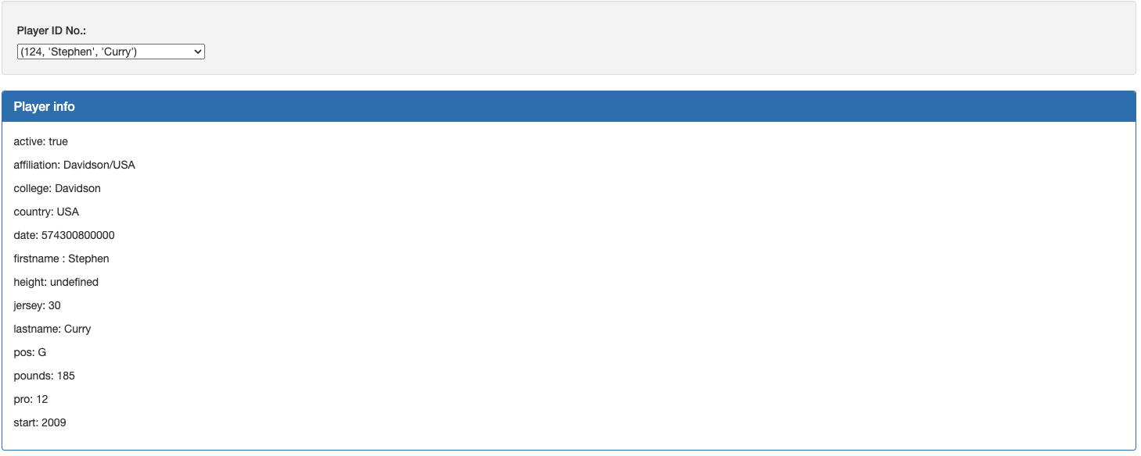
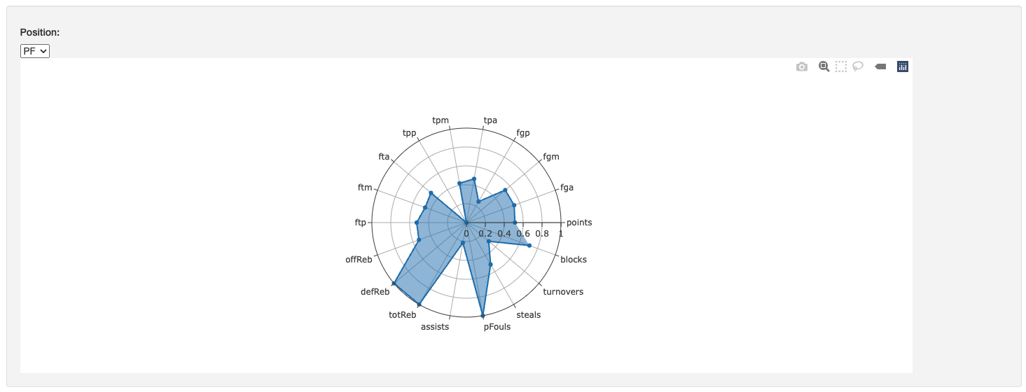
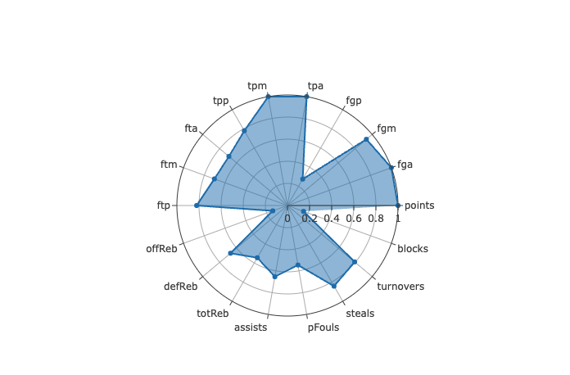
Visualizations - Demo

Slide 10
Insights
Skills that players presented did not necessarily match what is expected from their given position (e.g. Point Guard: there were higher free throw values than three point shots made)
Clusters showed players had opposing metrics (e.g. Cluster 2 high offReb and blocks)
PG, Cluster 1, & Cluster 3 groups with the highest assists also have the highest turnover rates

Slide 11
SASYR Team Neural Network Results:
Open to ideas and discussion early in the process
Success is not the only path to learning - as seen from the effort we put into creating spider charts in Tableau
Positive attitude towards roadblocks
Moral support is valuable support
Recognize strengths and weaknesses are like sticks that band together to form a log
If it is convoluted- there’s a better tool out there, use it!
Real world problem solving - require many iterations based on data understanding!

Slide 12

Thank You

